Slide 1
Real-time Anomaly Detection for Building Sensors Urban Data Lab Capstone Project Status Presentation
Data 599 Mitch Harris, Ryan Koenig, Nathan Smith June 1, 2021

Slide 2
Outline
Project Background
Current Progress
Challenges To-Date
Next Steps

Slide 3



MDS Project Team
Nathan Smith
Mitch Harris
Ryan Koenig

Slide 4
Project Background
Urban Data Lab
Project Description
Project Approach

Slide 5

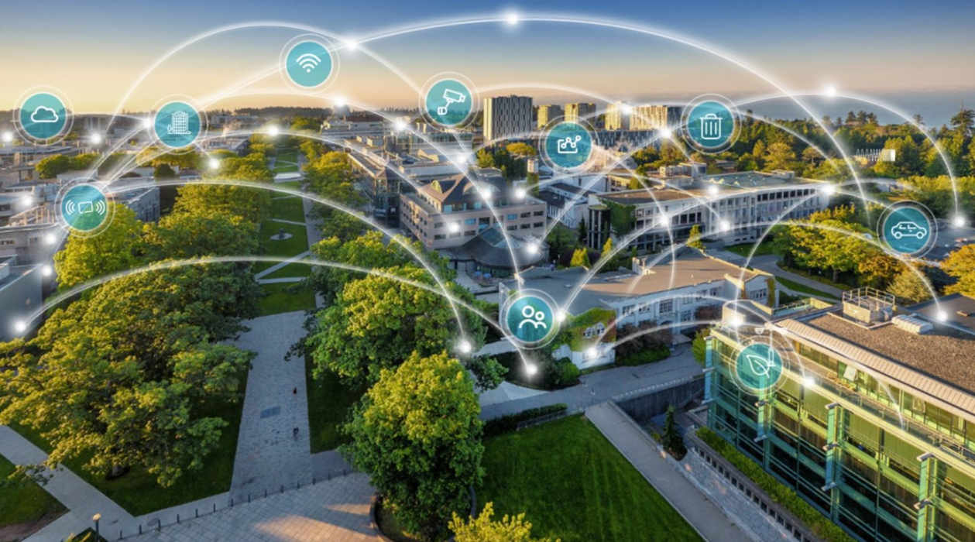
Urban Data Lab (UDL) Project Background
Advance data access, data management and data analytics capabilities on UBC campus.
Provides open access of UBC sustainability data to researchers, policymakers and operational staff.
Supports the monitoring and measurement of sustainability performance for buildings, transportation, and natural assets.

Slide 6
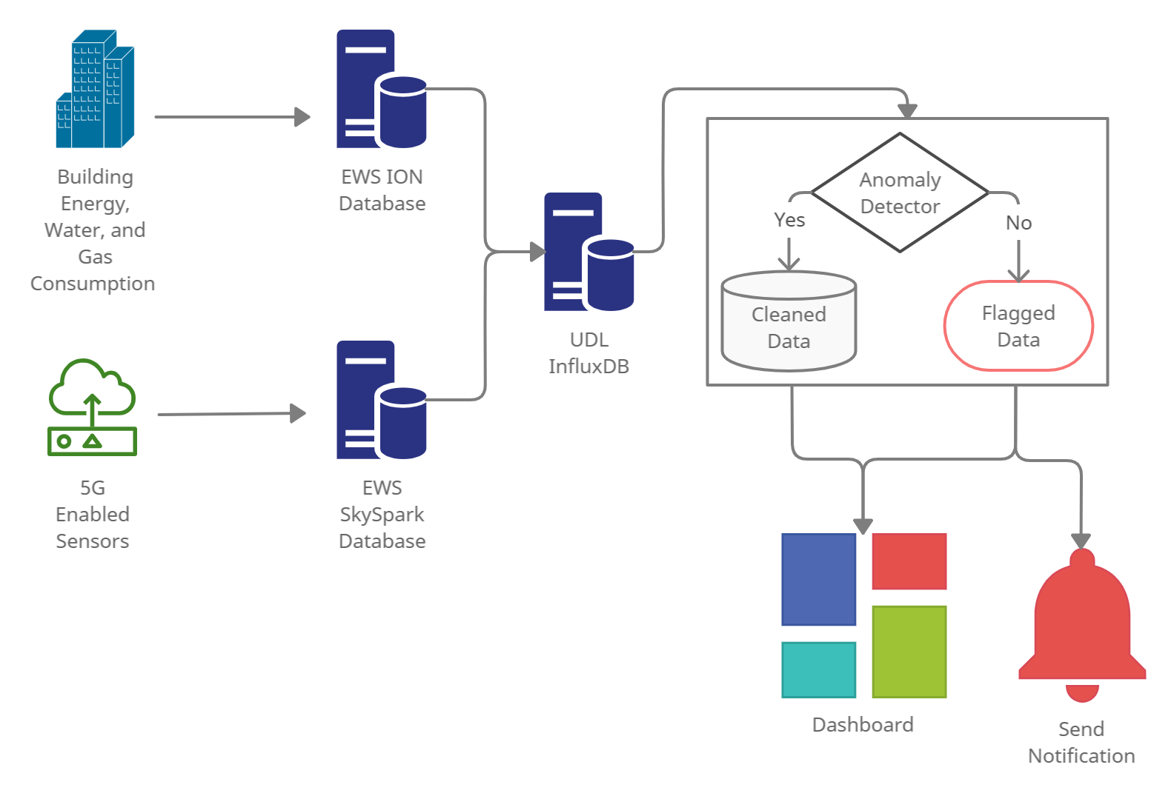
Description Project Background
UDL have noticed inconsistent/erroneous data – no system in place to identify this
UDL are interested in deployment of an anomaly detection system capable of notifying users of unusual behavior

Slide 7
Approach Project Background
Select a subset of data to use for the study
Select a real-time detection framework
Research anomaly detection models
Build a pipeline for the anomaly detection model
Model evaluation and tuning
Implement the model/framework
Build a dashboard/notification system

Slide 8
Current Progress
Select a subset of data to use for the study
Select a real-time detection framework
Research anomaly detection models
Build a pipeline for the anomaly detection model
Continued model evaluation and tuning
Implement the model/framework
Build a dashboard/notification system

Slide 9
Subset of Data Current Progress
Campus Energy Center (CEC) Boiler Data
50+ sensors
Temperature, Pressure, Flow, Gas
Varying resolution (1 min – 15 min)
~2-4 years available

Slide 10
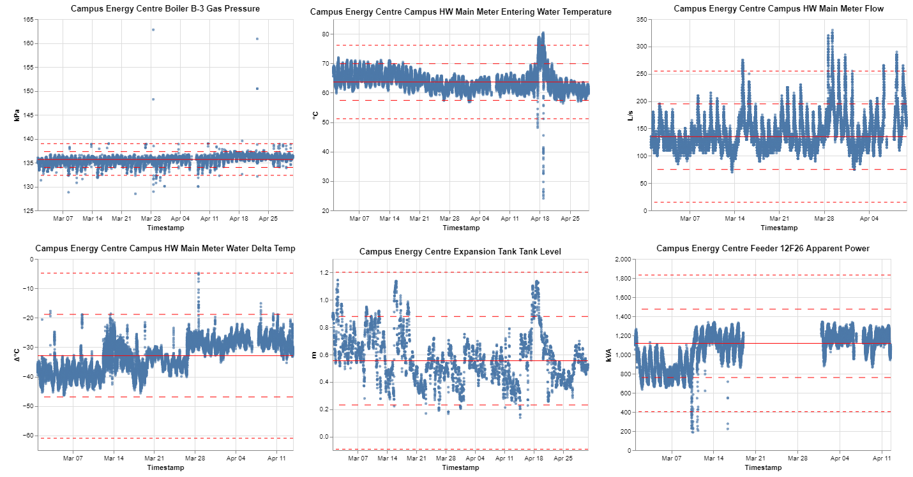
Subset of Data Current Progress
High variation in sensor patterns and anomalies types

Slide 11





Real-time Detection Framework Current Progress
Anomaly detection model are trained and parameters stored
Anomaly detector only reads latest points and uses stored parameters
Run Weekly/Monthly to Update Model
Raw
Model Parameters Stored
Parsed
Detected
Train Parameters
Continuous Read/Detect/Write

Slide 12
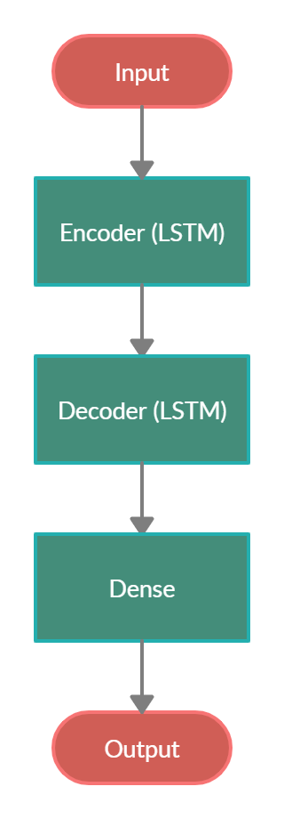
Anomaly Detection Model Current Progress
LSTM Encoder-Decoder Model Selected
Identified as a successful model on IoT sensors
Able to run in an unsupervised approach
Flexible model to handle different sensor types
Has tunable parameters

Slide 13
Anomaly Detection Model Current Progress
Two Model Setups Considered
X-2
X-1
X0
X-2
X-1
X0
X1’
X-2’
X-1’
X0’
Next Point Prediction
(Many-to-One)
Sequence Reconstruction
(Many-to-Many, Seq2Seq)

Slide 14
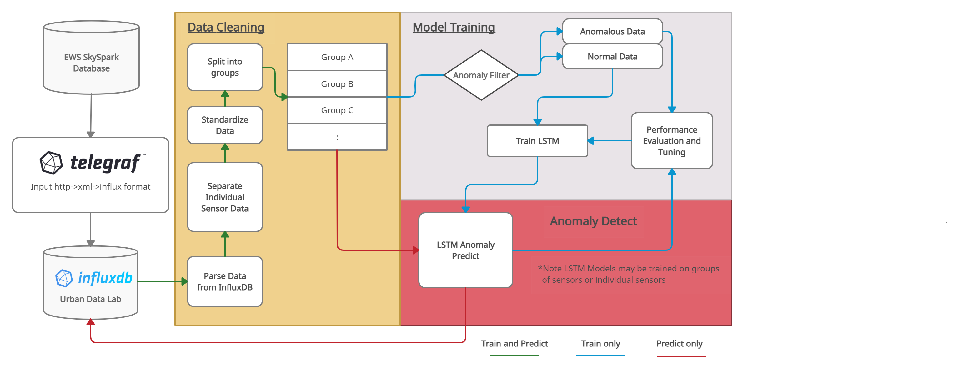
Build Model Pipeline Current Progress
Notes:
Training completed weekly/monthly
Predict on ongoing basis
Trains on normal data
Allows operational adjustment
Allows new sensor to use a similar sensor trained model to start detection

Slide 15
Build Model Pipeline Current Progress
Data Preparation
Sensors individual or grouped
Data standardized
Anomaly Screen/Filter
Trains on normal data only – any data already labelled anomalous is removed from training
Labelling anomalies to initially train the model will be done manually
LSTM-ED
2-layers stacked LSTM encoder-decoder for initial model
Modify as required (such as using a sliding window)
Tuning
Changing the threshold of labelling an anomaly for preferred results or potentially changing the period a sensor is trained on

Slide 16
Current Model Results Current Progress
Notes:
Training completed weekly/monthly
Predict on ongoing basis
Trains on normal data
Allows operational adjustment
Allows new sensor to use a similar sensor trained model to start detection

Slide 17
Current Model Results Current Progress
Notes:
Training completed weekly/monthly
Predict on ongoing basis
Trains on normal data
Allows operational adjustment
Allows new sensor to use a similar sensor trained model to start detection

Slide 18
Challenges To-Date
Data Access
Anomaly Labelling
Technology

Slide 19
Data Access Challenges
Historical or streaming data not currently available in InfluxDB
Support on parsing data using Telegraf
Manually downloading data

Slide 20
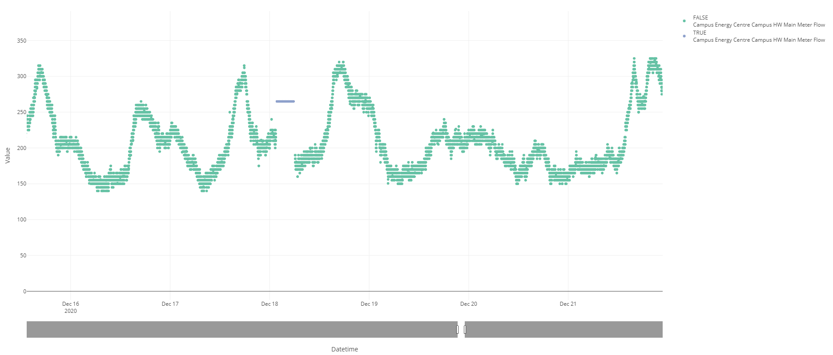
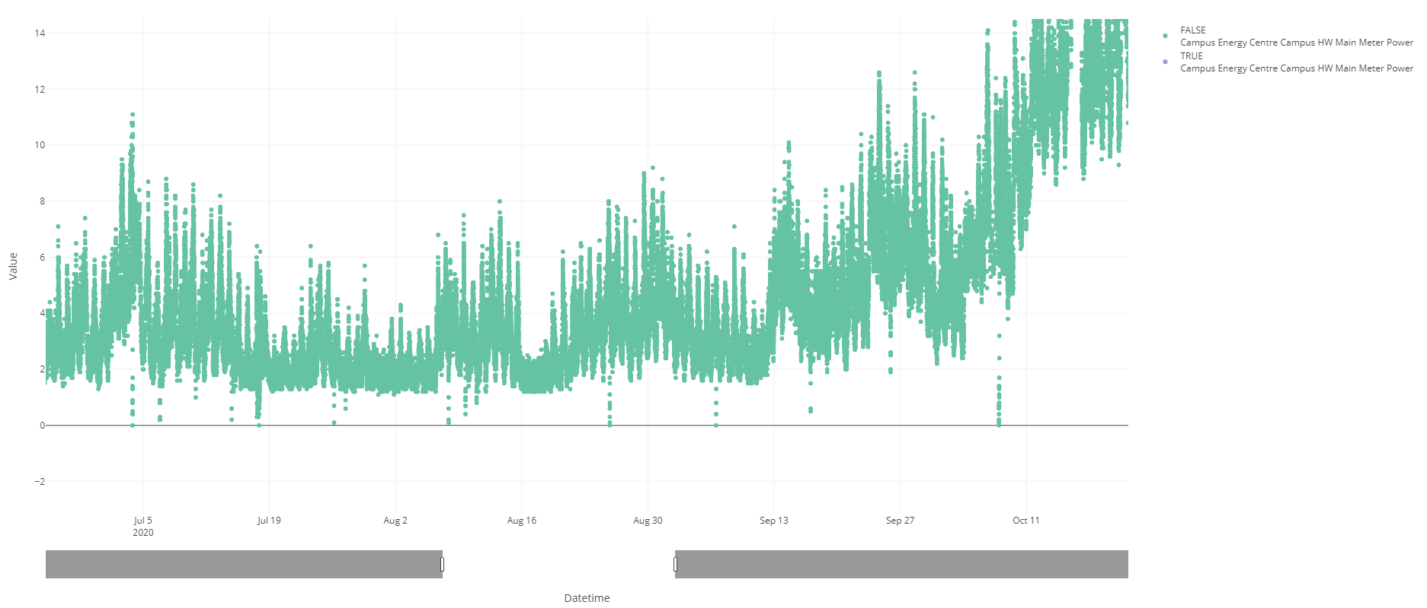
Anomaly Labelling Challenges
What is an anomaly?
Built an interactive app to support this
Still time intensive
Labelling is subjective
How to evaluate results?

Slide 21





Technology Challenges
A lot of tech to learn/explore in a short period

Slide 22
Next Steps
Select a subset of data to use for the study
Select a real-time detection framework
Research anomaly detection models
Build a pipeline for the anomaly detection model
Continued model evaluation and tuning
Implement the model/framework
Build a dashboard/notification system

Slide 23
Model Evaluation and Tuning Next Steps
Notes:
Training completed weekly/monthly
Predict on ongoing basis
Trains on normal data
Allows operational adjustment
Allows new sensor to use a similar sensor trained model to start detection

Slide 24
Implement Model Next Steps
Put the model into the real-time detection framework
Run Daily/Weekly to Update Model
Raw
Model Parameters Stored
Parsed
Detected
Train Parameters
Continuous Read/Detect/Write

Slide 25
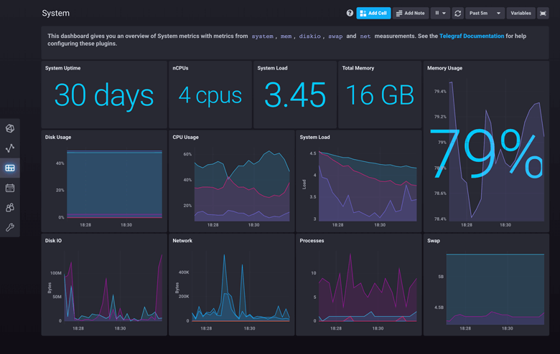
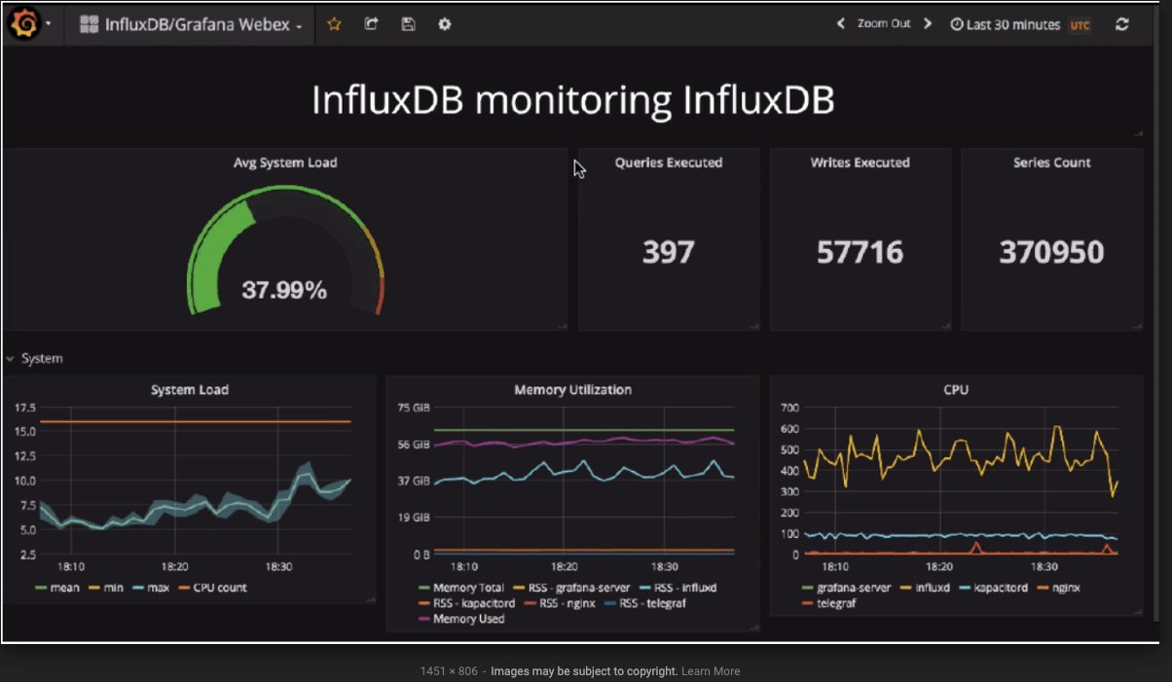
Dashboard/Notification System Next Steps
Likely built directly into InfluxDB, move to Grafana if required

Slide 26
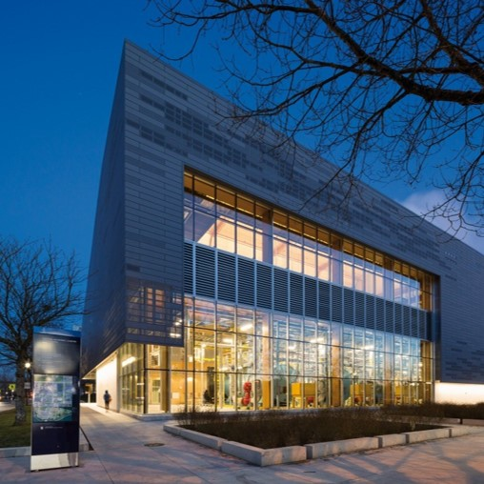
Q&A
Mitch Harris
Ryan Koenig
Nathan Smith

